Slide 1
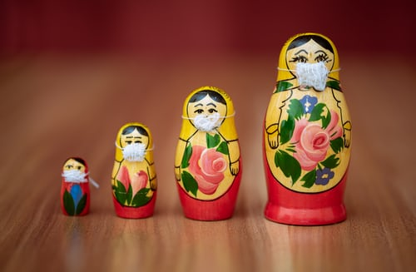

Disputes in charitable estates and the potential impact of COVID-19
COVID-19
Angela Bowman, National Head of Charities, Shoosmiths
Tom Dumont QC, Radcliffe Chambers
Dr James Warner, Halcyon Doctors

Slide 2
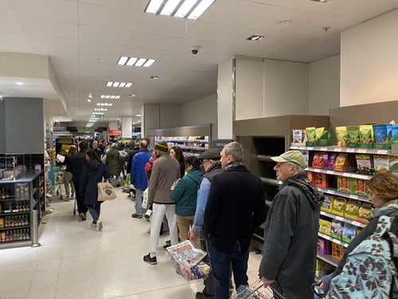
deVere Group saw a 76% increase in demand for wills in the first two weeks of March, shortly prior to the lockdown

Slide 3
“…the coronavirus pandemic has had an unprecedented, collective focusing-of-minds effect.”
Nigel Green CEO of deVere Group

Slide 4
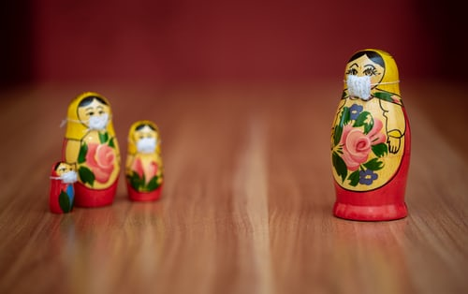
Given the problems being posed by COVID-19, is there likely to be an increase in claims against estates and, if so, why?
COVID-19

Slide 5

What potential effects can COVID-19 have on a testator’s testamentary capacity?
COVID-19

Slide 6
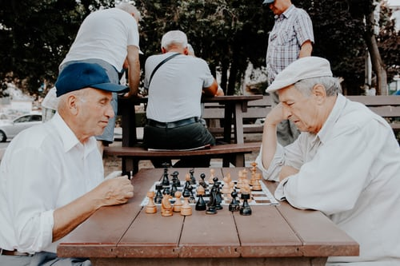
Are we likely to see more challenges to Wills based upon lack of testamentary capacity?
COVID-19

Slide 7
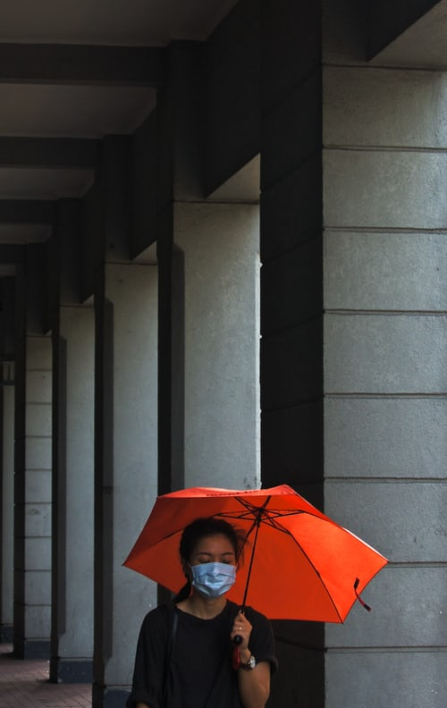
Is COVID-19 likely to result in more undue influence claims and/or to lead to more situations of financial abuse?
COVID-19

Slide 8
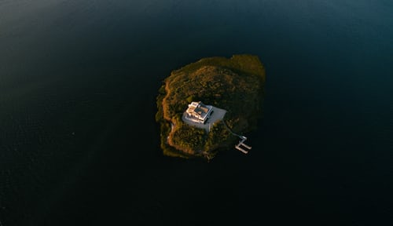
What can the effects of isolation be on an elderly testator?
COVID-19

Slide 9

Is the virus likely to result in more Inheritance Act claims?
COVID-19

Slide 10
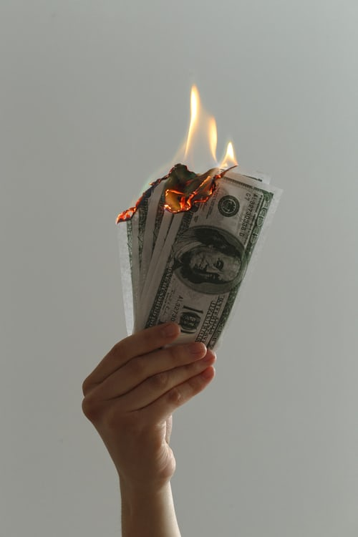
How can you reduce the risk of invalid wills being made and help minimise the risk of claims?
COVID-19

Slide 11

Encourage supporters to use a solicitor
Promote good will writing practice – detailed notes, advice re witnessing
Make sure notes with reasons for excluding family are +ive re charity, not –ive re family
Capacity assessment
Make the best will you can now, and a better one after COVID-19
COVID-19

Slide 12
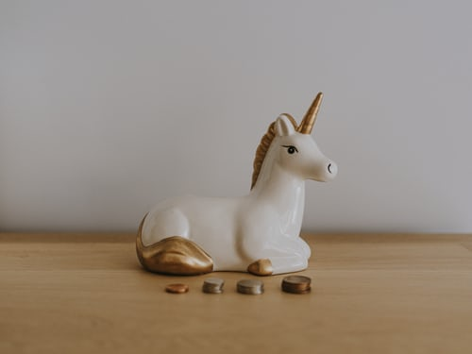
What steps can charities take to attempt to increase legacy income during these difficult times?
COVID-19

Slide 13
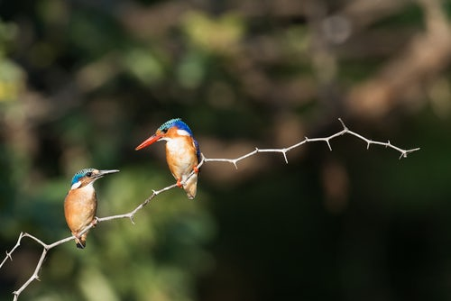
Encourage lifetime donor to give now?
Encourage interim distributions
Inform administrators of workarounds
Settle/Mediate
COVID-19

